Slide 1

CTeSP Redes e Sistemas Informáticos
Segurança Informática
Filipe André Martins de Freitas

Slide 2
IDS and IPS Characteristics

Slide 3
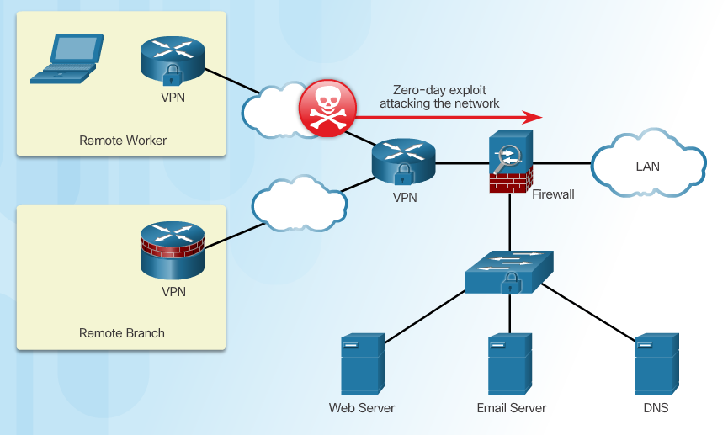
Zero-Day Attacks
Notes:
5.1.1.1 Zero Day Attacks

Slide 4
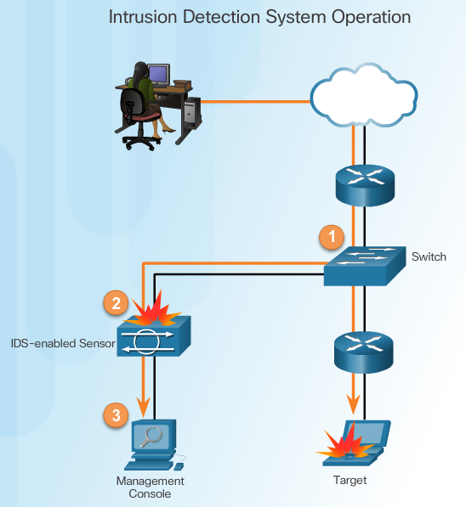
Monitor for Attacks
Advantages of an IDS:
Works passively
Requires traffic to be mirrored in order to reach it
Network traffic does not pass through the IDS unless it is mirrored
Notes:
5.1.1.2 Monitor for Attacks

Slide 5
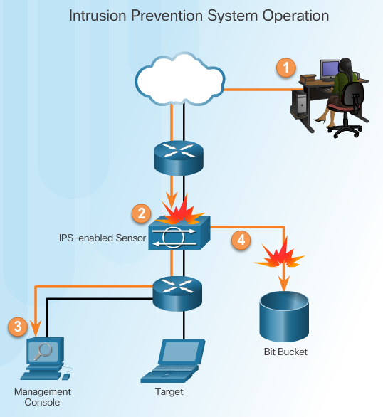
Detect and Stop Attacks
IPS:
Implemented in an inline mode
Monitors Layer 3 and Layer 4 traffic
Can stop single packet attacks from reaching target
Responds immediately, not allowing any malicious traffic to pass
Notes:
5.1.1.3 Detect and Stop Attacks

Slide 6
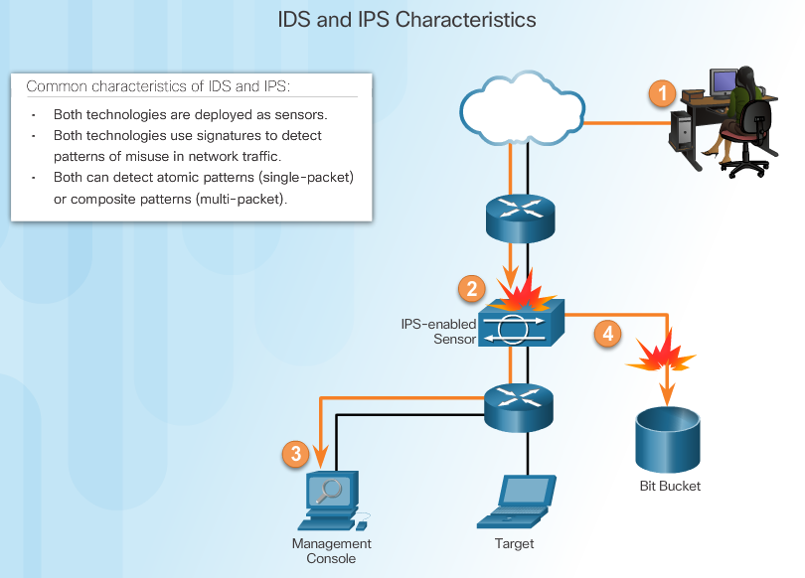
Similarities Between IDS and IPS
Notes:
5.1.1.4 Similarities Between IDS and IPS

Slide 7
Advantages and Disadvantages of IDS and IPS
Advantages IDS:
No impact on network
No network impact if there is a sensor failure
No network impact if there is a sensor overload
Advantages IPS:
Stops trigger packets
Can use stream normalization techniques
Disadvantages IDS:
Response action cannot stop trigger
Correct tuning required for response actions
More vulnerable to network security evasion techniques
Disadvantages IPS:
Sensor issues might affect network traffic
Sensor overloading impacts the network
Some impact on network
Notes:
5.1.1.5 Advantages and Disadvantages of IDS and IPS

Slide 8
Network-Based IPS Implementations

Slide 9
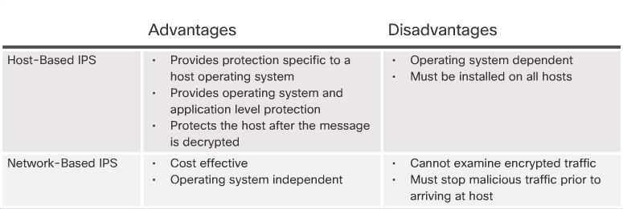
Host-Based and Network-Based IPS
Notes:
5.1.2.1 Host-Based and Network-Based IPS

Slide 10
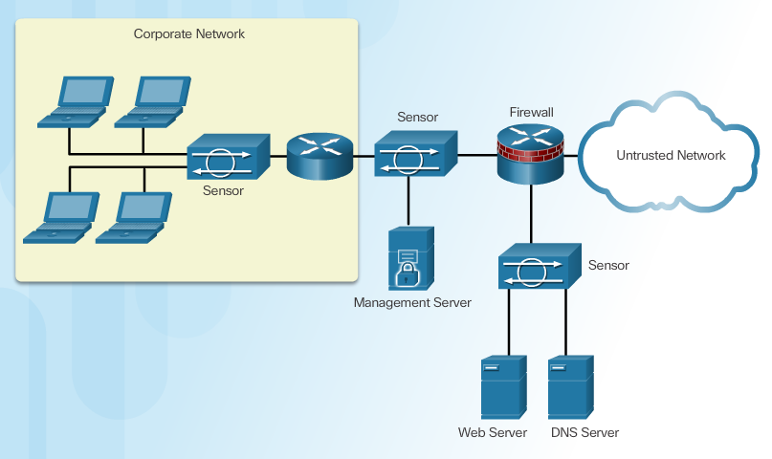
Network-Based IPS Sensors
Notes:
5.1.2.2 Network-Based IPS Sensors

Slide 11
Choose an IPS Solution
Factors affecting the IPS sensor selection and deployment:
Amount of network traffic
Network topology
Security budget
Available security staff to manage IPS
Notes:
5.1.2.5 Choose an IPS Solution

Slide 12
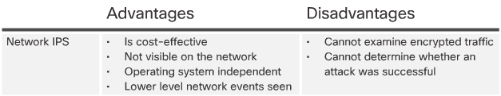
IPS Advantages and Disadvantages
Notes:
5.1.2.6 IPS Advantages and Disadvantages

Slide 13
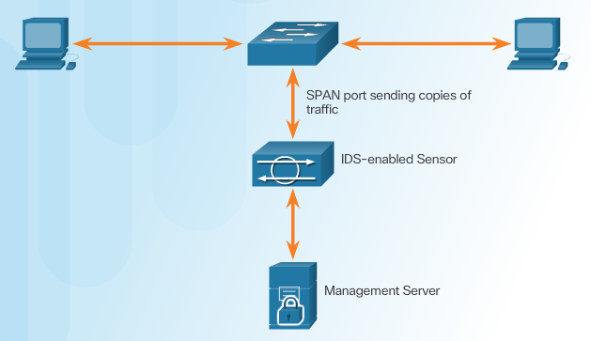

Modes of Deployment
Promiscuous Mode
Inline Mode
Notes:
5.1.2.7 Modes of Deployment

Slide 14
Cisco Switched Port Analyzer

Slide 15
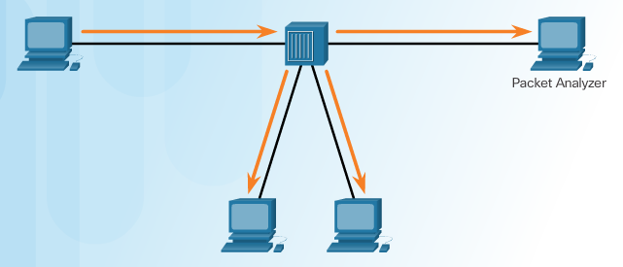
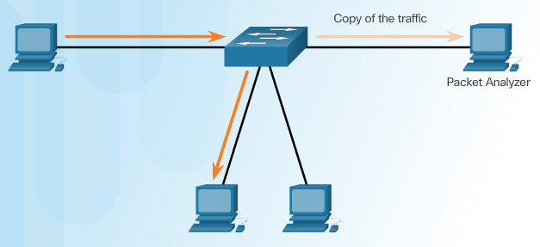
Port Mirroring
Traffic Sniffing Using a Hub
Traffic Sniffing Using a Switch
Notes:
5.1.3.1 Port Mirroring

Slide 16
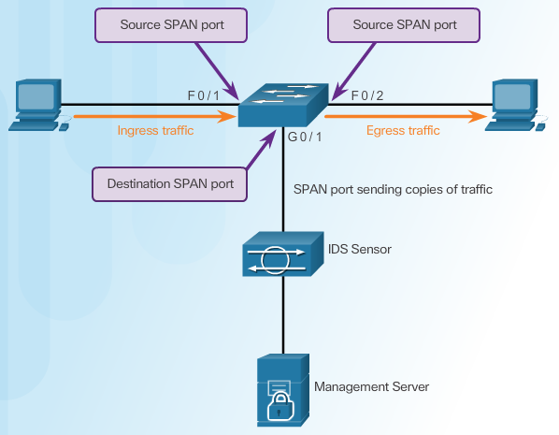
Cisco SPAN
Notes:
5.1.3.2 Cisco SPAN

Slide 17


Configuring Cisco SPAN Using Intrusion Detection
Cisco SPAN Commands:
Monitor session command – used to associate a source port and a destination port with a SPAN session.
Show monitor command – used to verify the SPAN session.
Notes:
5.1.3.3 Configuring Cisco SPAN Using Intrusion Detection

Slide 18
IPS Signatures
Upon completion of the section, you should be able to:
Understand IPS signature characteristics
Explain IPS signature alarms
Manage and monitor IPS
Understand the global correlation of Cisco IPS devices

Slide 19
IPS Signature Characteristics

Slide 20
Signature Attributes
A signature is a set of rules that an IDS and an IPS use to detect typical intrusion activity.
Signatures have three distinct attributes:
Type
Trigger (alarm)
Action
Notes:
5.2.1.1 Signature Attributes

Slide 21
Signature Types
Signatures are categorized as either:
Atomic – this simplest type of signature consists of a single packet, activity, or event that is examined to determine if it matches a configured signature. If yes, an alarm is triggered and a signature action is performed.
Composite – this type of signature identifies a sequence of operations distributed across multiple hosts over an arbitrary period of time.
Notes:
5.2.1.2 Signature Types

Slide 22
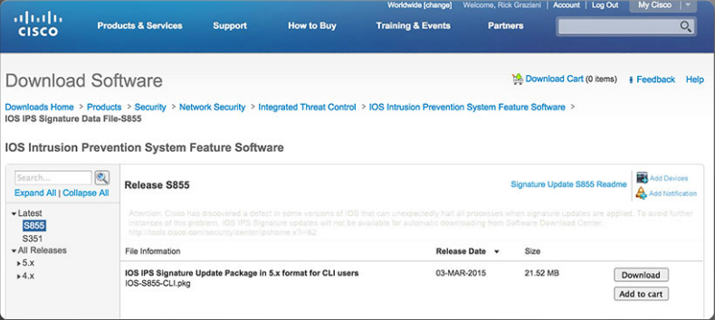
Signature File
As new threats are identified, new signatures must be created and uploaded to an IPS.
A signature file contains a package of network signatures.
Notes:
5.2.1.3 Signature File

Slide 23
Signature Micro-Engines
Cisco IOS defines five micro-engines:
Atomic – Signatures that examine simple packets.
Service – Signatures that examine the many services that are attacked.
String - Signatures that use regular expression-based patterns to detect intrusions.
Multi-string – Supports flexible pattern matching and Trend Labs signatures.
Other – Internal engine that handles miscellaneous signatures.
Notes:
5.2.1.4 Signature Micro-Engines

Slide 24
Download a Signature File
Notes:
5.2.1.5 Acquire the Signature File
5.2.1.6 Activity – Identify IPS Signature Type

Slide 25
IPS Signature Alarms

Slide 26
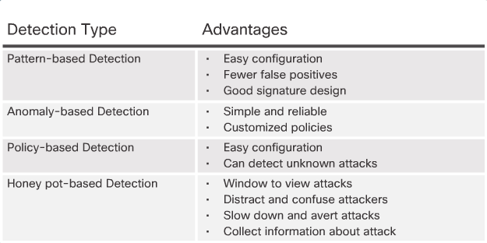
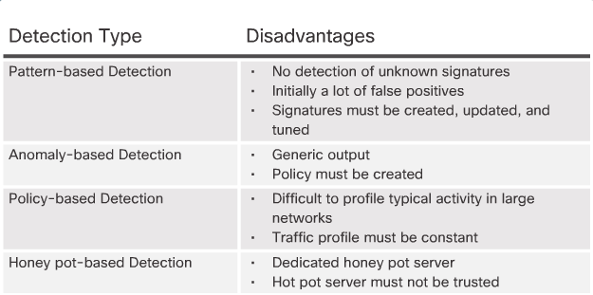
Signature Alarm
Notes:
5.2.2.1 Signature Alarm

Slide 27
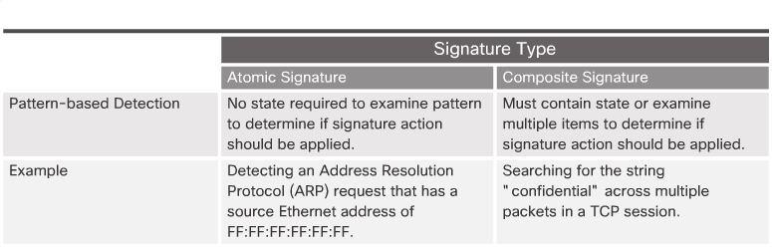
Pattern-Based Detection
Notes:
5.2.2.2 Pattern-Based Detection

Slide 28
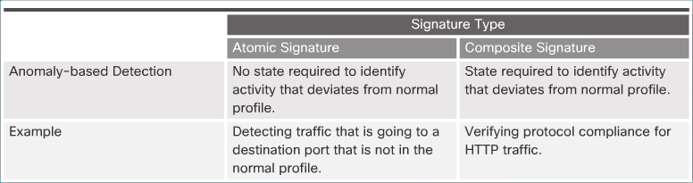
Anomaly-Based Detection
Notes:
5.2.2.3 Anomaly-Based Detection

Slide 29
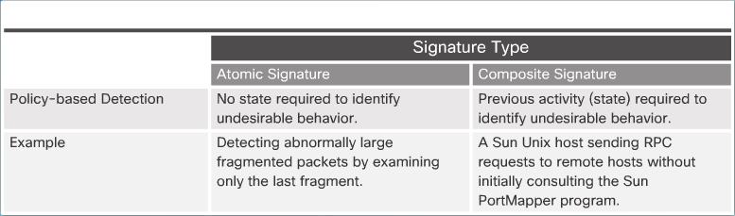
Policy-Based and Honey Pot-Based Detection
Notes:
5.2.2.4 Policy-Based and Honey Pot-Based Detection

Slide 30
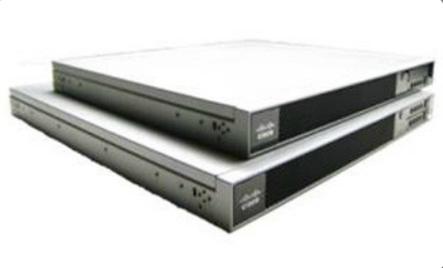
Benefits of the Cisco IOS IPS Solution
Benefits:
It uses underlying routing infrastructure to provide an additional layer of security.
It is inline and is supported on a broad range of routing platforms.
It provides threat protection at all entry points to the network when used in combination with Cisco IDS, Cisco IOS Firewall, VPN, and NAC solutions
The size of the signature database used by the devices can be adapted to the amount of available memory in the router.
Notes:
5.2.2.5 Benefits of the Cisco IOS IPS Solution

Slide 31
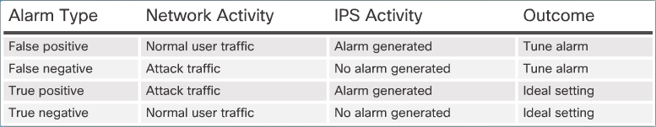
Alarm Triggering Mechanisms
Understanding Alarm Types:
Notes:
5.2.2.6 Alarm Triggering Mechanisms
5.2.2.7 Activity – IPS Signature Alarms

Slide 32
IPS Signature Actions

Slide 33
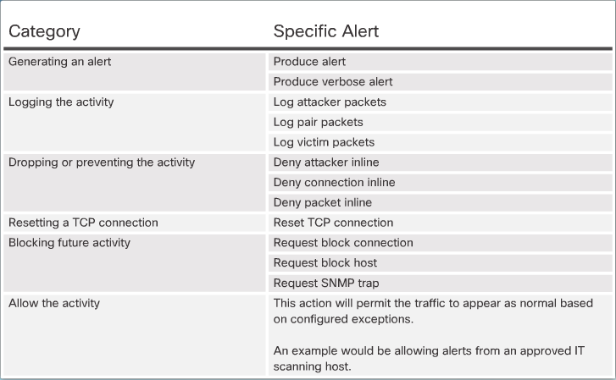
Signature Actions
Summary of Action Categories:
Notes:
5.2.3.1 Signature Actions

Slide 34
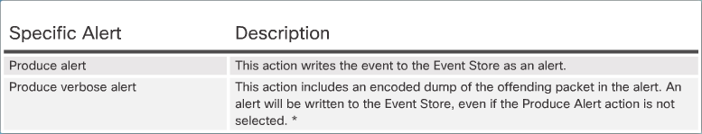
Manage Generated Alerts
Generating an Alert:
Notes:
5.2.3.2 Manage Generated Alerts

Slide 35
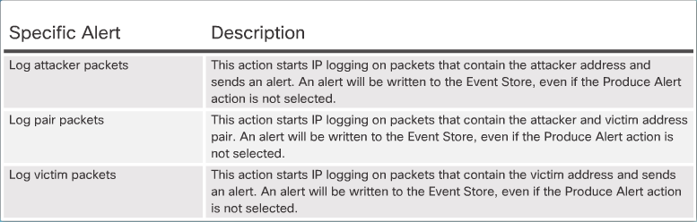
Log Activities for Later Analysis
Logging the Activity:
Notes:
5.2.3.3 Log Activities for Later Analysis

Slide 36
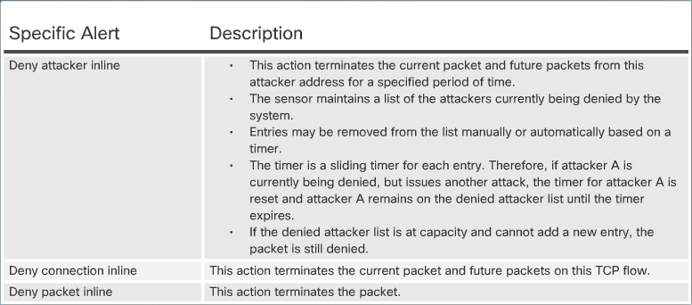
Deny the Activity
Dropping or Preventing the Activity:
Notes:
5.2.3.4 Deny the Activity

Slide 37
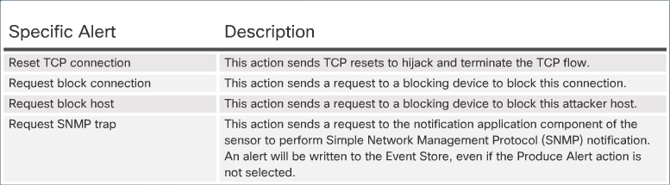
Reset, Block, and Allow Traffic
Resetting the Connection and Blocking the Activity:
Notes:
5.2.3.5 Reset, Block, and Allow Traffic
5.2.3.6 Activity – Identify the IPS Signature Action

Slide 38
Manage and Monitor IPS

Slide 39
Monitor Activity
IPS Planning and Monitoring Considerations:
Management method
Event correlation
Security staff
Incident response plan
Notes:
5.2.4.1 Monitor Activity

Slide 40
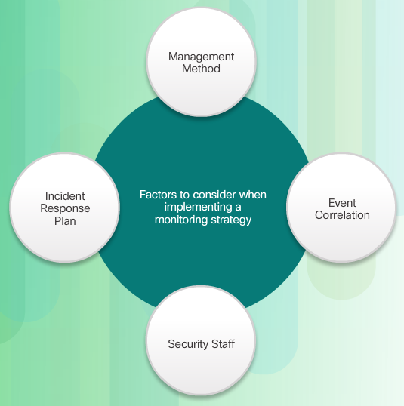
Monitoring Considerations
Notes:
5.2.4.2 Monitoring Considerations

Slide 41
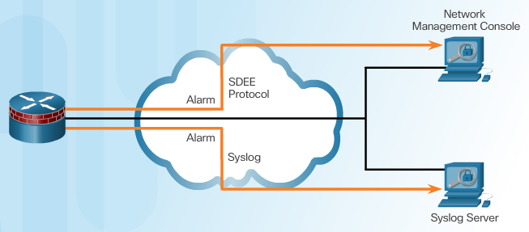
Secure Device Event Exchange
Notes:
5.2.4.3 Secure Device Event Exchange

Slide 42
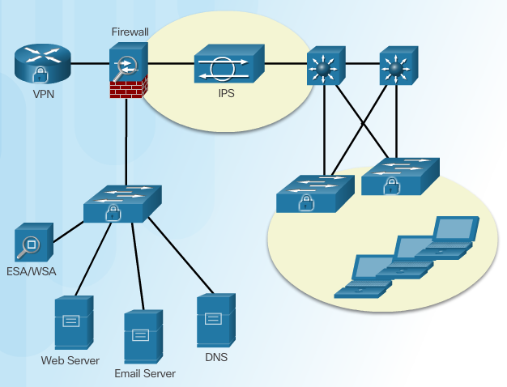
IPS Configuration Best Practices
Notes:
5.2.4.4 IPS Configuration Best Practices

Slide 43
IPS Global Correlation

Slide 44
Cisco Global Correlation
Goals of global correlation:
Dealing intelligently with alerts to improve effectiveness
Improving protection against known malicious sites
Sharing telemetry data with the SensorBase Network to improve visibility of alerts and sensor actions on a global scale
Simplifying configuration settings
Automatic handling of security information uploads and downloads
Notes:
5.2.5.1 Cisco Global Correlation

Slide 45
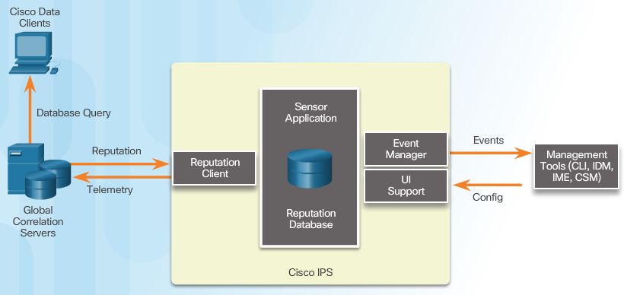
Cisco SensorBase Network
Notes:
5.2.5.2 Cisco SensorBase Network

Slide 46
Cisco Security Intelligence Operation
Network participation gathers the following data:
Signature ID
Attacker IP address
Attacker port
Maximum segment size
Victim IP address
Victim port
Signature version
TCP options string
Reputation score
Risk rating
Notes:
5.2.5.3 Cisco Security Intelligence Operation

Slide 47
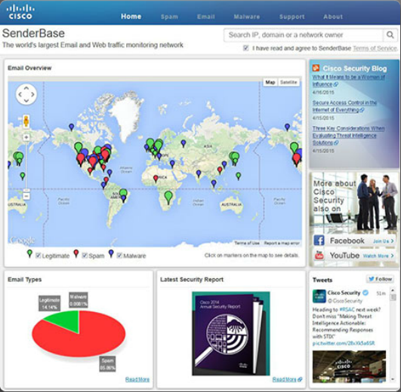
Reputations, Blacklists, and Traffic Filters
Notes:
5.2.5.4 Reputations, Blacklists, and Traffic Filters
5.2.5.5 Reputations, Blacklists, and Traffic Filters (Cont.)

Slide 48
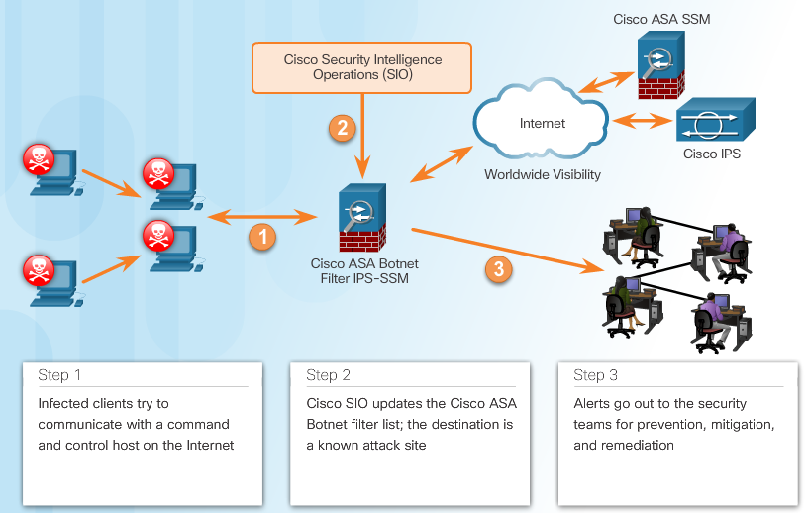
Reputations, Blacklists, and Traffic Filters
Notes:
5.2.5.4 Reputations, Blacklists, and Traffic Filters
5.2.5.5 Reputations, Blacklists, and Traffic Filters (Cont.)

Slide 49
Implement IPS
Upon completion of this section, you should be able to:
Understand how to configure Cisco IOS IPS with CLI
Explain how to verify and monitor IPS

Slide 50
Configure Cisco IOS IPS with CLI

Slide 51
Implement IOS IPS
Step 1. Download the IOS IPS files.
Step 2. Create an IOS IPS configuration directory in Flash.
Step 3. Configure an IOS IPS crypto key.
Step 4. Enable IOS IPS.
Step 5. Load the IOS IPS signature package to the router.
Notes:
5.3.1.1 Implement IOS IPS

Slide 52
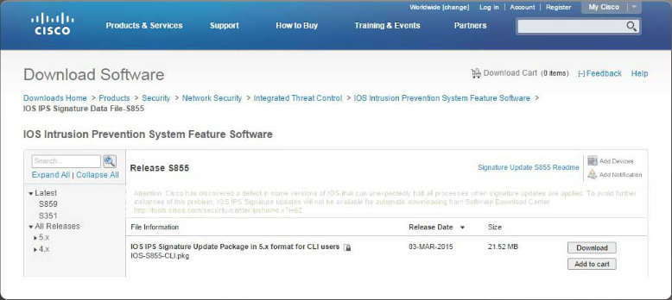
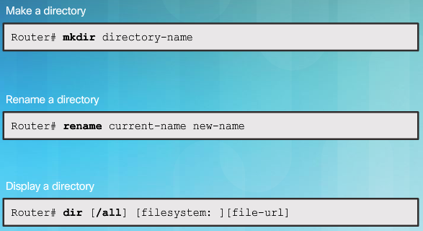
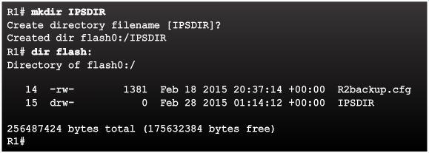
Download the IOS IPS Files
Notes:
5.3.1.2 Download the IOS IPS Files
5.3.1.3 IPS Crypto Key
5.3.1.4 Enable IOS IPS
5.3.1.5 Load the IPS Signature Package in RAM

Slide 53
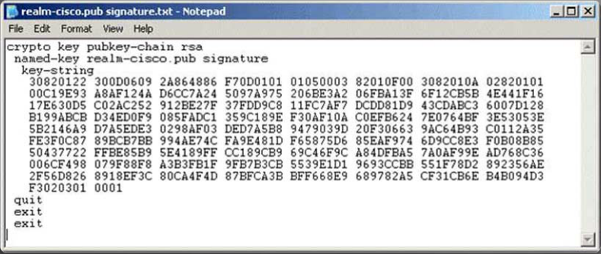
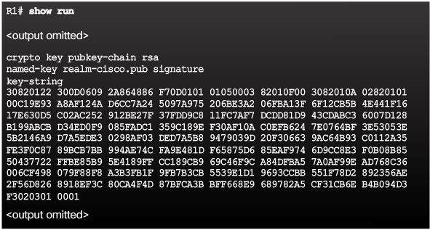
IPS Crypto Key
Notes:
Page 5.3.1.3

Slide 54
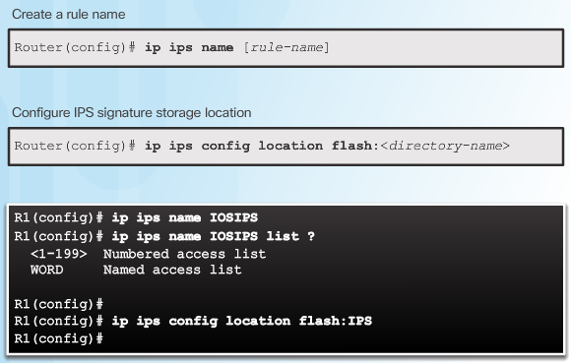
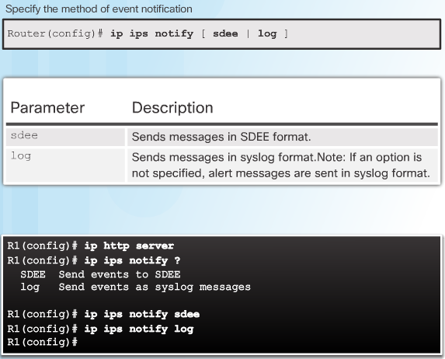
Enable IOS IPS
Notes:
Page 5.3.1.4

Slide 55
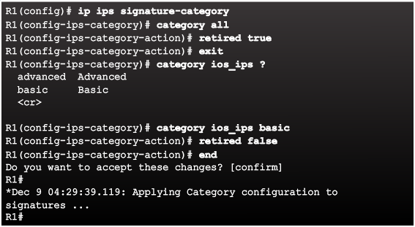
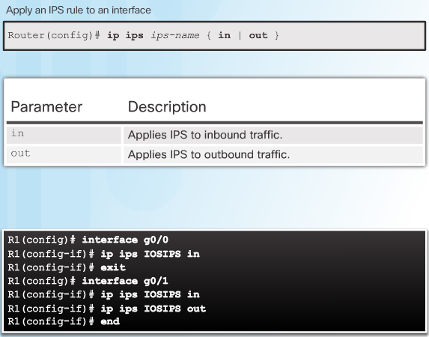
Enable IOS IPS
Notes:
Page 5.3.1.4 (cont.)

Slide 56
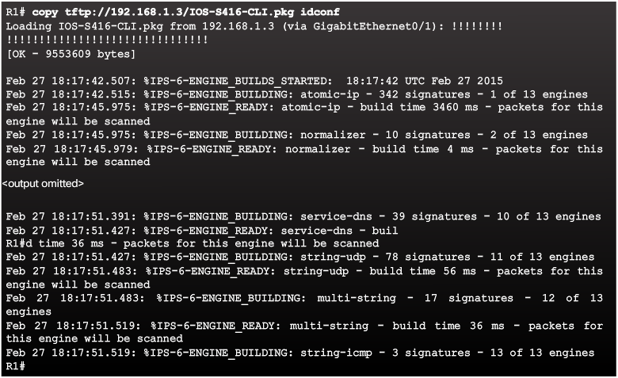
Load the IPS Signature Package in RAM
Notes:
5.3.1.5 Load the IPS Signature Package in RAM

Slide 57
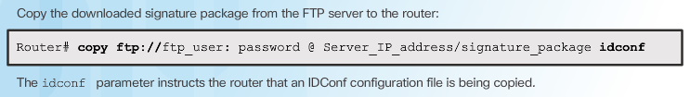
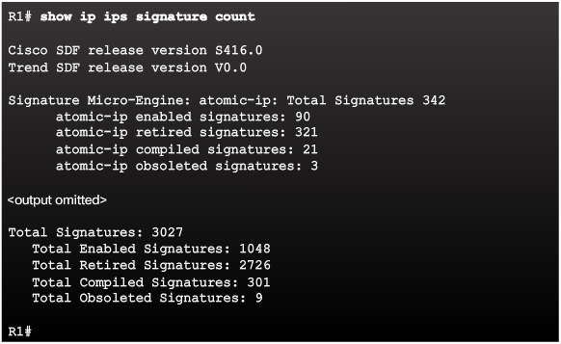
Load the IPS Signature Package in RAM
Notes:
5.3.1.5 Load the IPS Signature Package in RAM (Cont.)
5.3.1.6 Activity – Implementing IPS

Slide 58
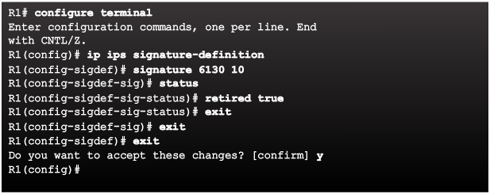
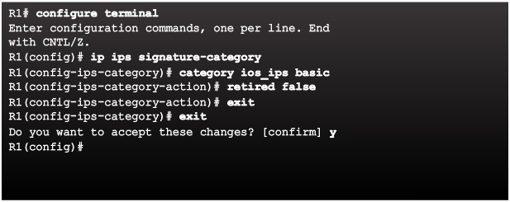
Retire and Unretire Signatures
Retiring an Individual Signature:
Retiring a Signature Category:
Notes:
5.3.2.1 Retire and Unretire Signatures

Slide 59
Modifying Cisco IOS IPS Signatures

Slide 60
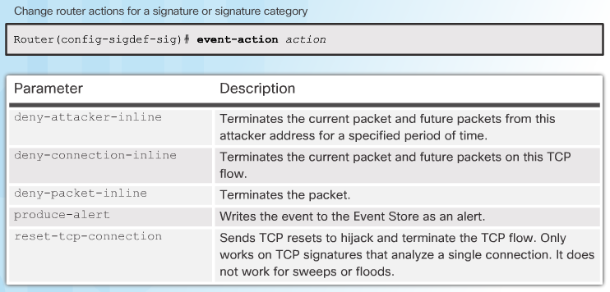
Change Signature Actions
Notes:
5.3.2.2 Change Signature Actions

Slide 61
Verify and Monitor IPS

Slide 62
Verify IOS IPS
Show commands to verify the IOS IPS configuration:
show ip ips
show ip ips all
show ip ips configuration
show ip ips interfaces
show ip ips signatures
show ip ips statistics
Clear commands to disable IPS:
clear ip ips configuration
clear ip ips statistics
Notes:
5.3.3.1 Verify IOS IPS

Slide 63
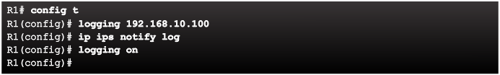
Report IPS Alerts
Notes:
5.3.3.2 Report IPS Alerts

Slide 64
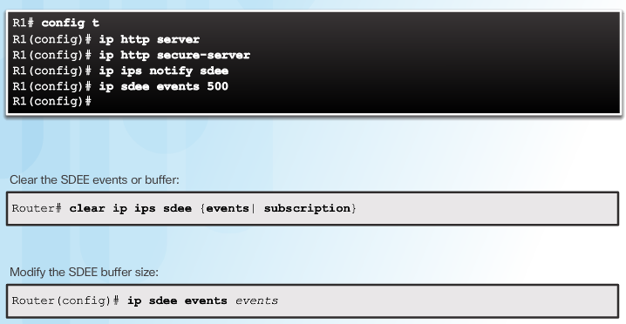
Enable SDEE
Notes:
5.3.3.3 Enable SDEE

Slide 65
DÚVIDAS ?!

Slide 66


